Slide 1
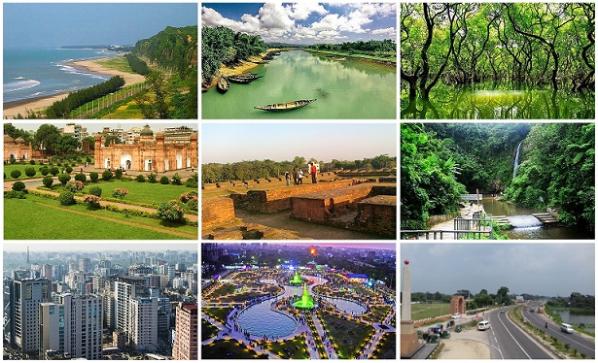
Major tourist spots in Bangladesh

Slide 2

Tourism is one of the world’s fastest-growing industries and a major foreign exchange and employment generator for many countries. It is one of the most remarkable economic and social phenomena.
The word ‘tour’ is derived from the Latin word tornus, meaning ‘a tool for making a circle.’
Tourism may be defined as the movement of people from their usual place of residence to another place ( with the intention to return) for a minimum period of twenty-four hours to a maximum of six months for the individual purpose of leisure.

Slide 3
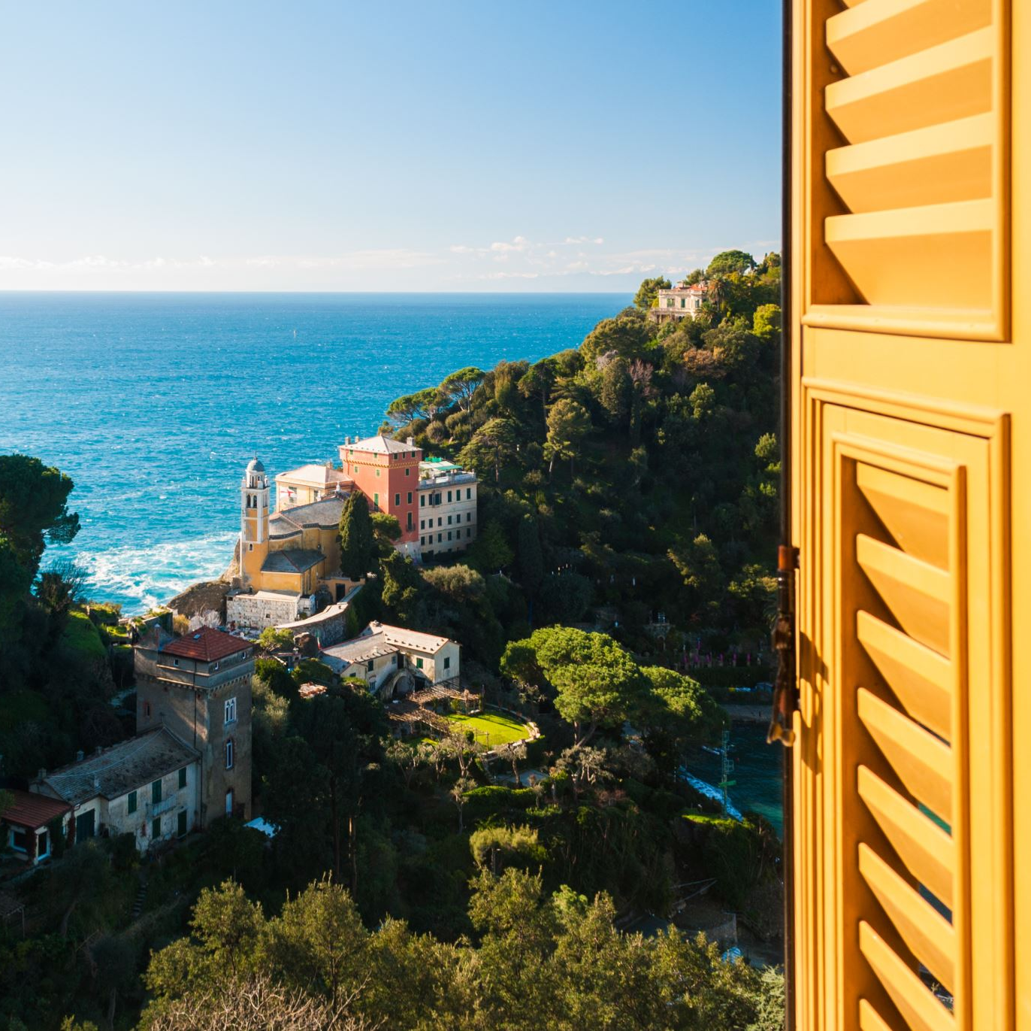
According to WTO (1993), “Tourism encompasses the activities of persons traveling and staying in places outside their usual environment for not more than one consecutive year for leisure, business, and other purposes.” The Rome conference on tourism in 1963 defined tourism as ‘a visit to a country other than one’s own or where one usually resides and works.

Slide 4

Tourism
International Tourism
Domestic Tourism
Inbound Toursim
Outbound Tourism

Slide 5
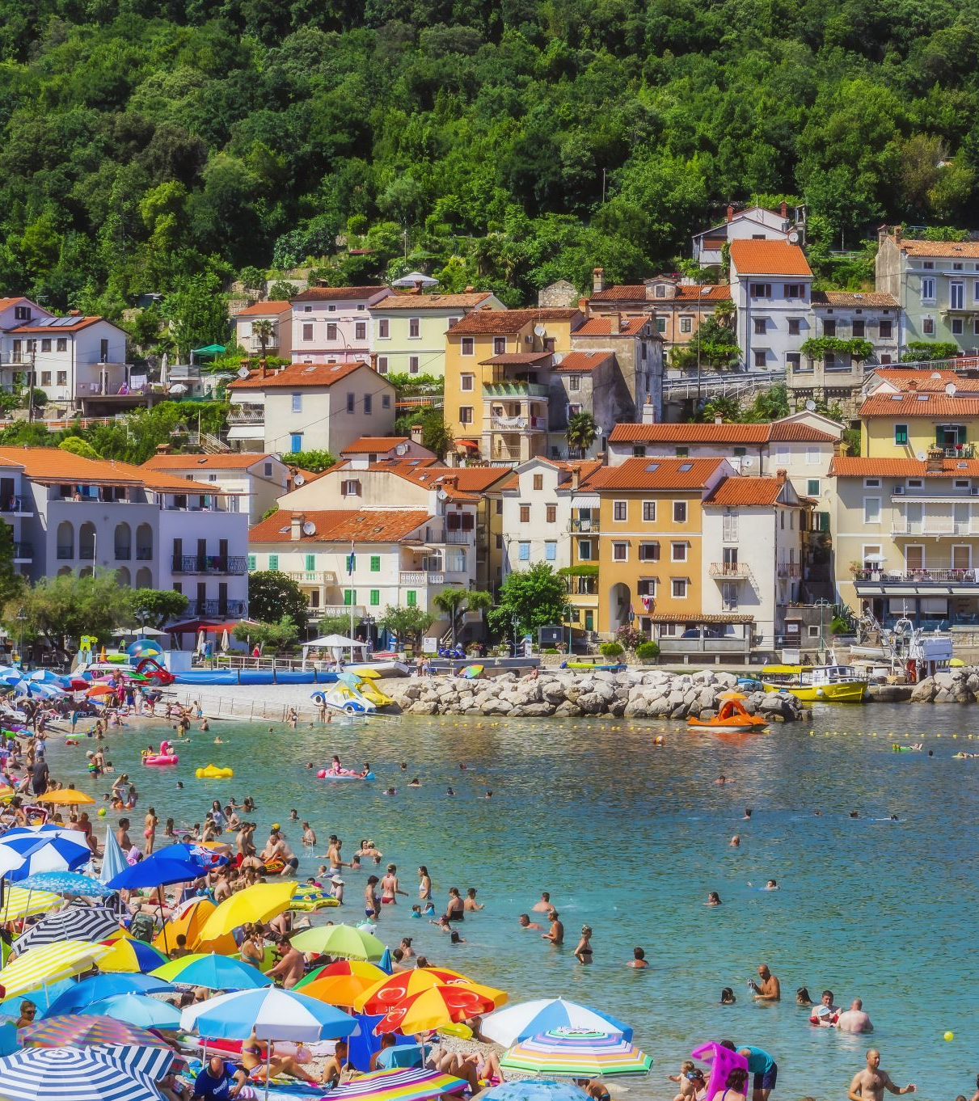
Classification of Tourism
Tourism can be classified into six categories according to the purpose of travel. These are the following:
Recreational: Recreational or leisure tourism takes a person away from the boring of everyday life. In this case, people spend their leisure time in the hills, sea beaches, etc.
Cultural tourism satisfies cultural and intellectual curiosity and involves visits to ancient monuments, places of historical or religious importance, etc.
Sports/Adventure: Trips taken by people with a view to playing golf, hiking, fall, surfing, rafting etc. within this category.

Slide 6
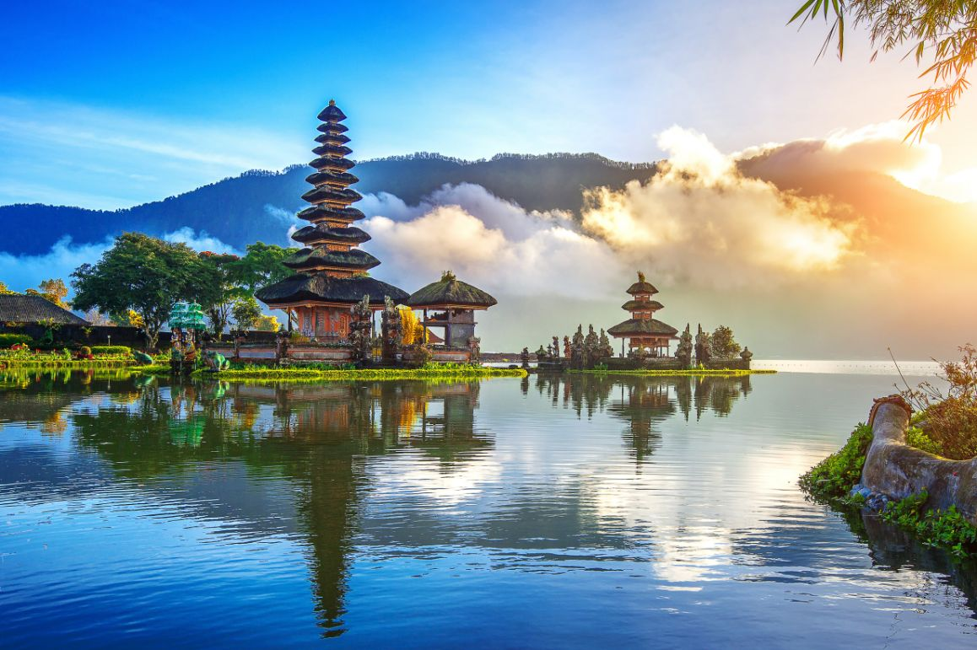
Classification of Tourism
4. Health: Under this category, people travel for medical, treatment or visit places where there are health-giving possibilities, for example, hot springs, spa yoga, etc.
5. Convention Tourism: It is becoming an increasingly important component of travel. People travel within a country or overseas to attend conventions relating to their business, profession, or interest.
6. Incentive Tourism: Holiday trips are offered as incentives by major companies to dealers and salesmen who achieve high targets in sales. This is a new and expanding phenomenon in tourism, These are in position of cash incentives or gifts, Today incentive tourism is a 3 billion dollar business in the USA alone.
Any other types?? Destination wedding?

Slide 7
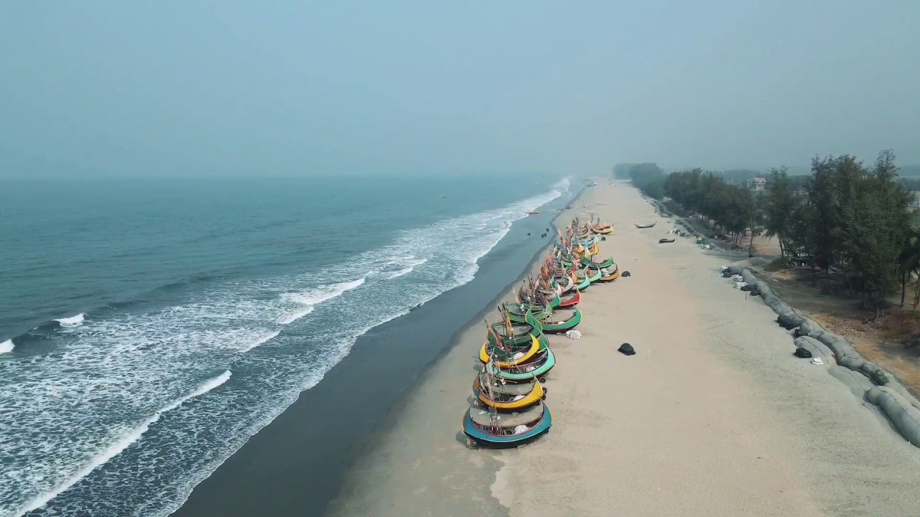
Cox’s Bazar
World's Longest Beach: World's longest natural sandy beach, extending an unbroken 155 kilometers along the Bay of Bengal.
Peaceful Beaches: The beach itself is known for its soft, golden sand, gentle waves, and stunning sunsets.
Flourishing Tourist Hub: Cox's Bazar is a busy tourist destination, offering a wide range of accommodations, restaurants, and entertainment options. From budget-friendly guesthouses to luxurious resorts, there's something for every traveler's budget and style.
Adventure Activities: Cox's Bazar offers a variety of water sports, including surfing, parasailing, and jet skiing.

Slide 8
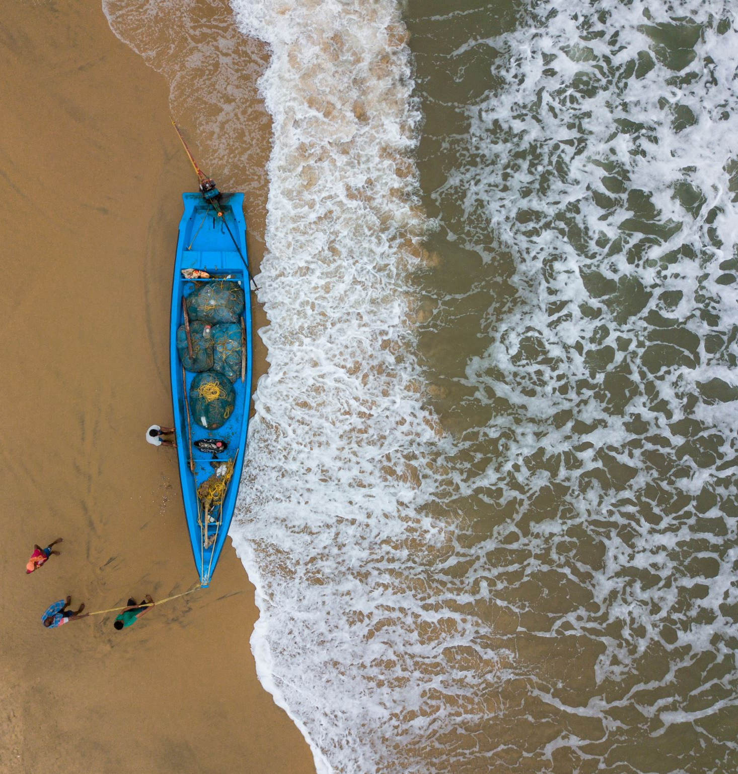
Cox’s Bazar
Natural Wonders: Venture beyond the beach to discover the natural beauty of Cox's Bazar. Hike through the lavish forests of Himchari National Park, home to diverse wildlife and flowing waterfalls. Embark on a boat trip to Sonadia Island, a wildlife preserve and nesting ground for sea turtles.
Family-Friendly Fun: Cox's Bazar is a haven for families, with plenty of kid-friendly activities and attractions.

Slide 9
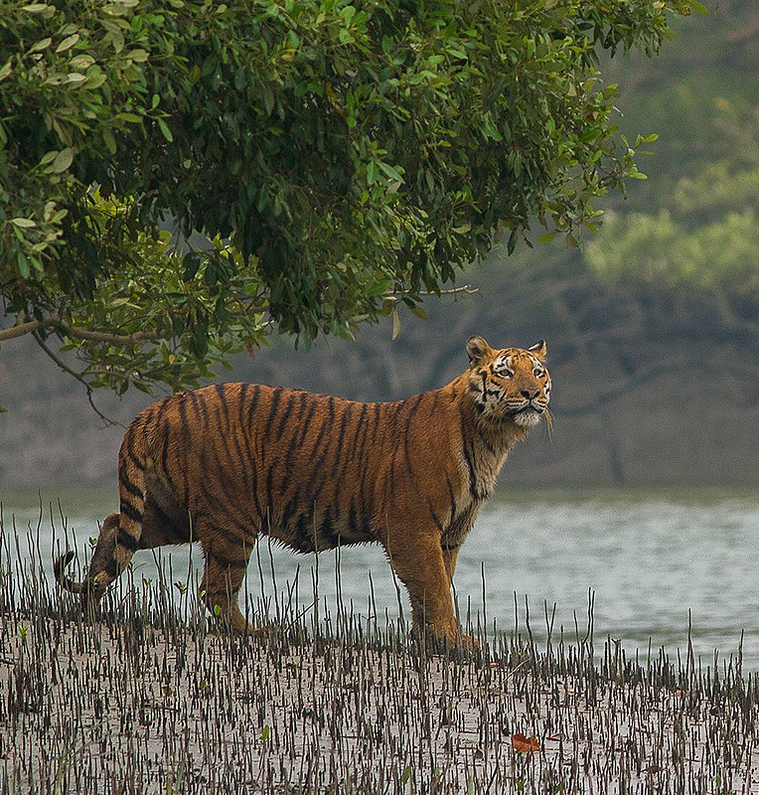
SUNDARBAN
World's Largest Mangrove Forest: The Sundarbans is the world's largest mangrove forest, across over 10,000 square kilometers. This UNESCO World Heritage Site is home to an improbable diversity of flora and fauna, making it a must-visit for eco-tourists.
Royal Bengal Tiger Habitat: With an estimated population of over 1,000 tigers, the Sundarbans offers a unique opportunity to spot these magnificent creatures in their natural environment.
Diverse Wildlife: Sundarban is home to a rich array of wildlife, including elephants, spotted deer, crocodiles, monkeys, snakes, and over 500 species of birds.

Slide 10
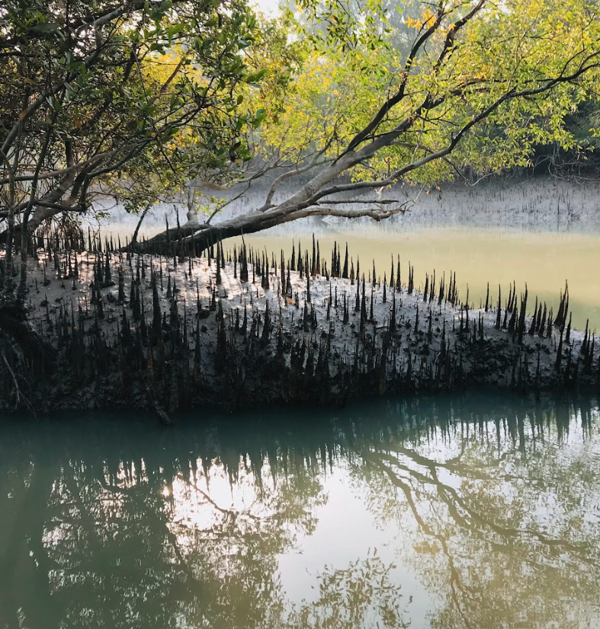
SUNDARBAN
Birdwatching Paradise: The Sundarbans is a paradise for birdwatchers.
Thriving River Ecosystem: The Sundarbans is crisscrossed by a network of rivers and waterways, creating a unique ecosystem.
Cultural Involvement: The Sundarbans is home to indigenous communities that have lived in harmony with the forest for centuries.

Slide 11
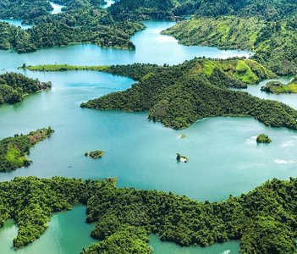
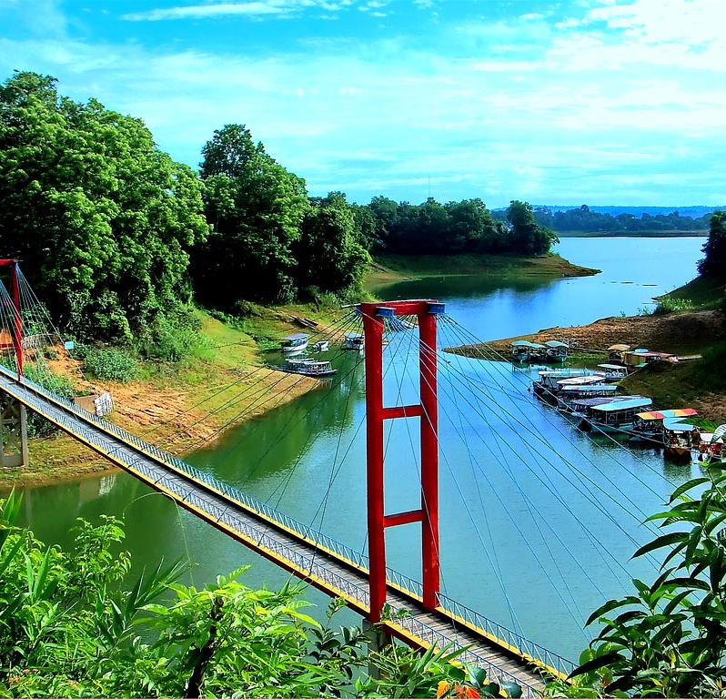
RANGAMATI
For having red soil, this district name is Rangamati.
Has also many attractive natural tourist place.
capital lake, hanging bridge, echo Village and more.

Slide 12
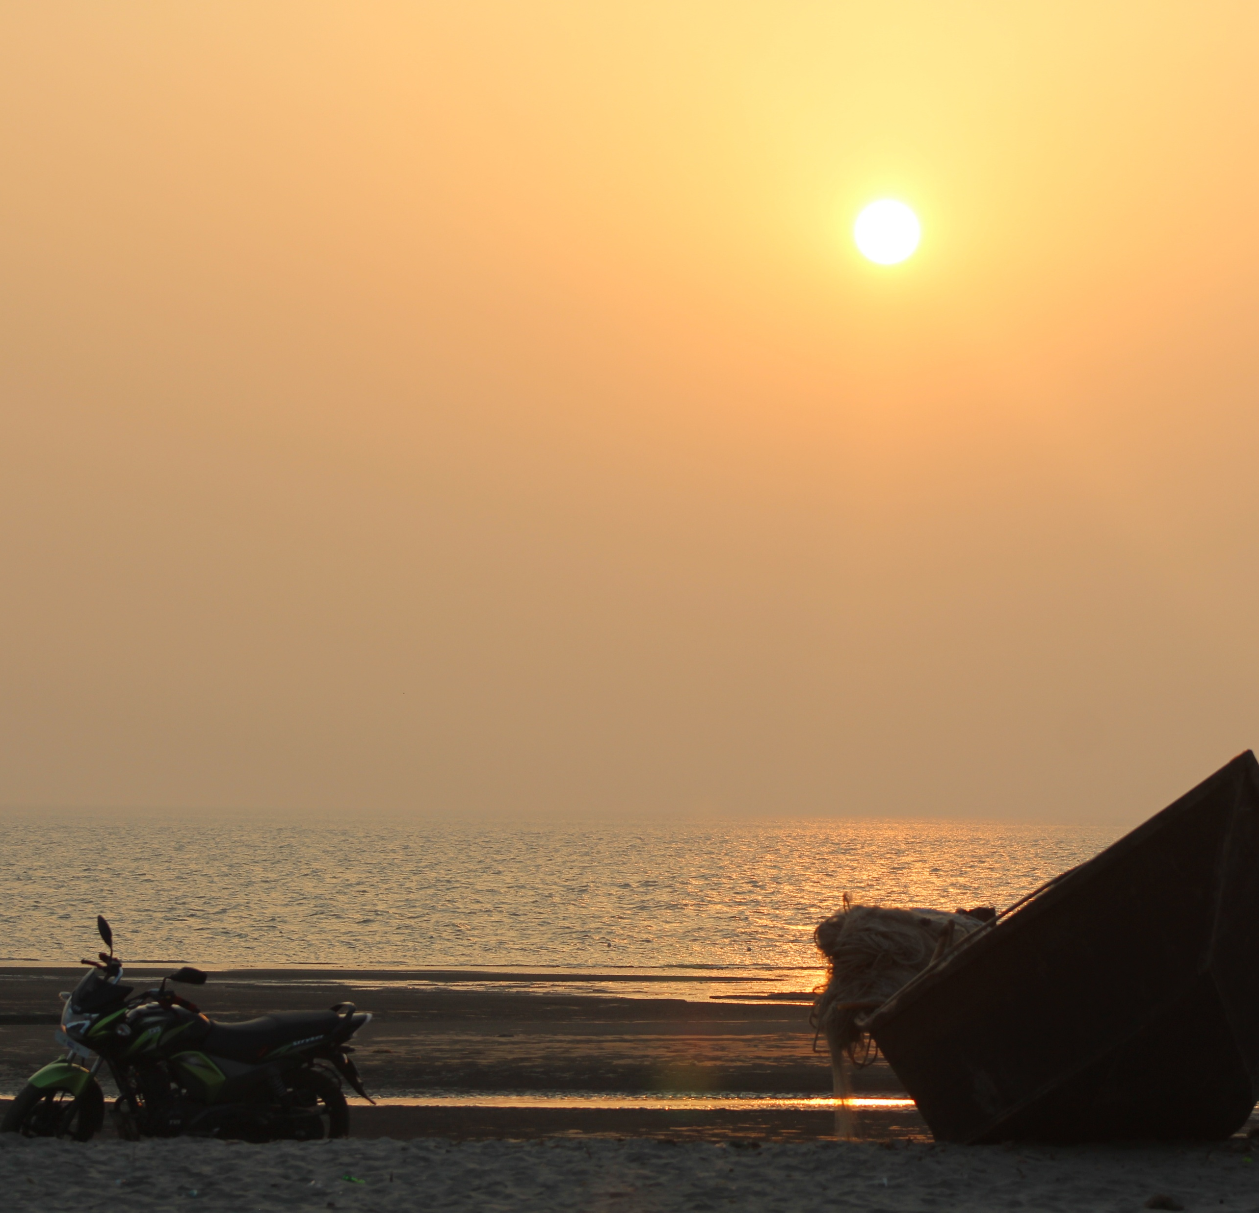
KUAKATA SEA BEACH
Kuakata is a bird's-eye sea beach on the southern most tip of Bangladesh. Located in the Patuakhali district, Kuakata has a wide sandy beach from where one can see both the sunrise and sunset. It is about 320 Kilometers south of Dhaka, the capital, and about 70 Kilometers from the district headquarters. The Kuakata beach is 30 km long and 6 km wide.

Slide 13
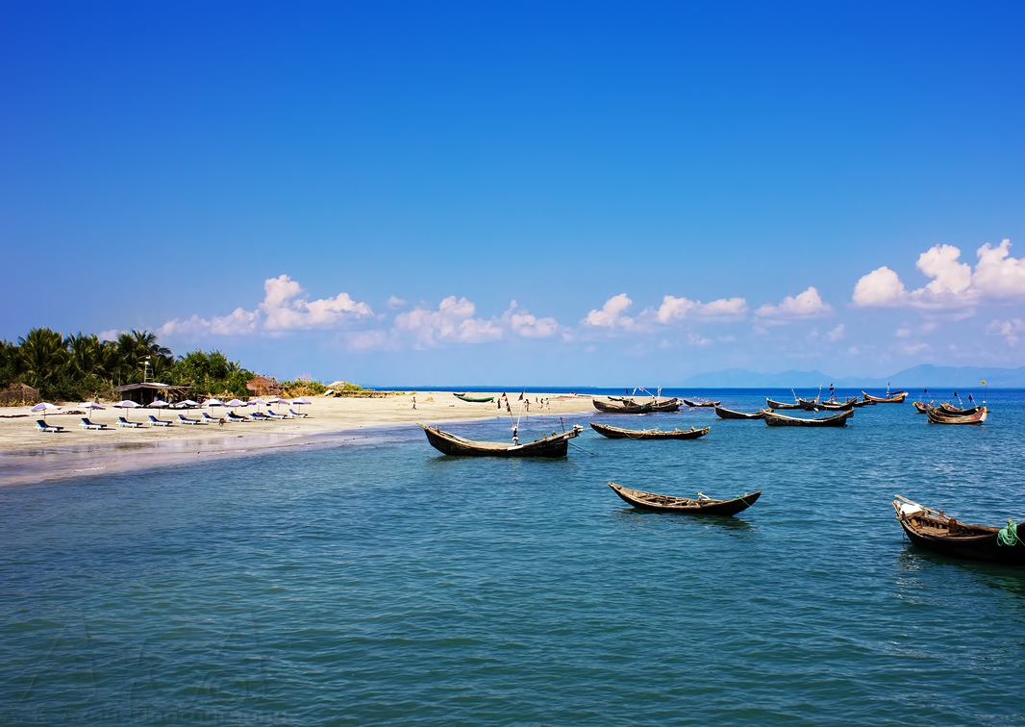
St. Martin's Island
St. Martin's Island is a small island (area only 8 km2) in the northeastern part of the Bay of Bengal, about 9 km south of the tip of the Cox's Bazar-Teknaf and forming the southern most part of Bangladesh. There is a small adjoining island that is separated at high tide, called Chhera island. It is about 8 km west of the northwest coast of Myanmar, at the mouth of the Naf River.

Slide 14
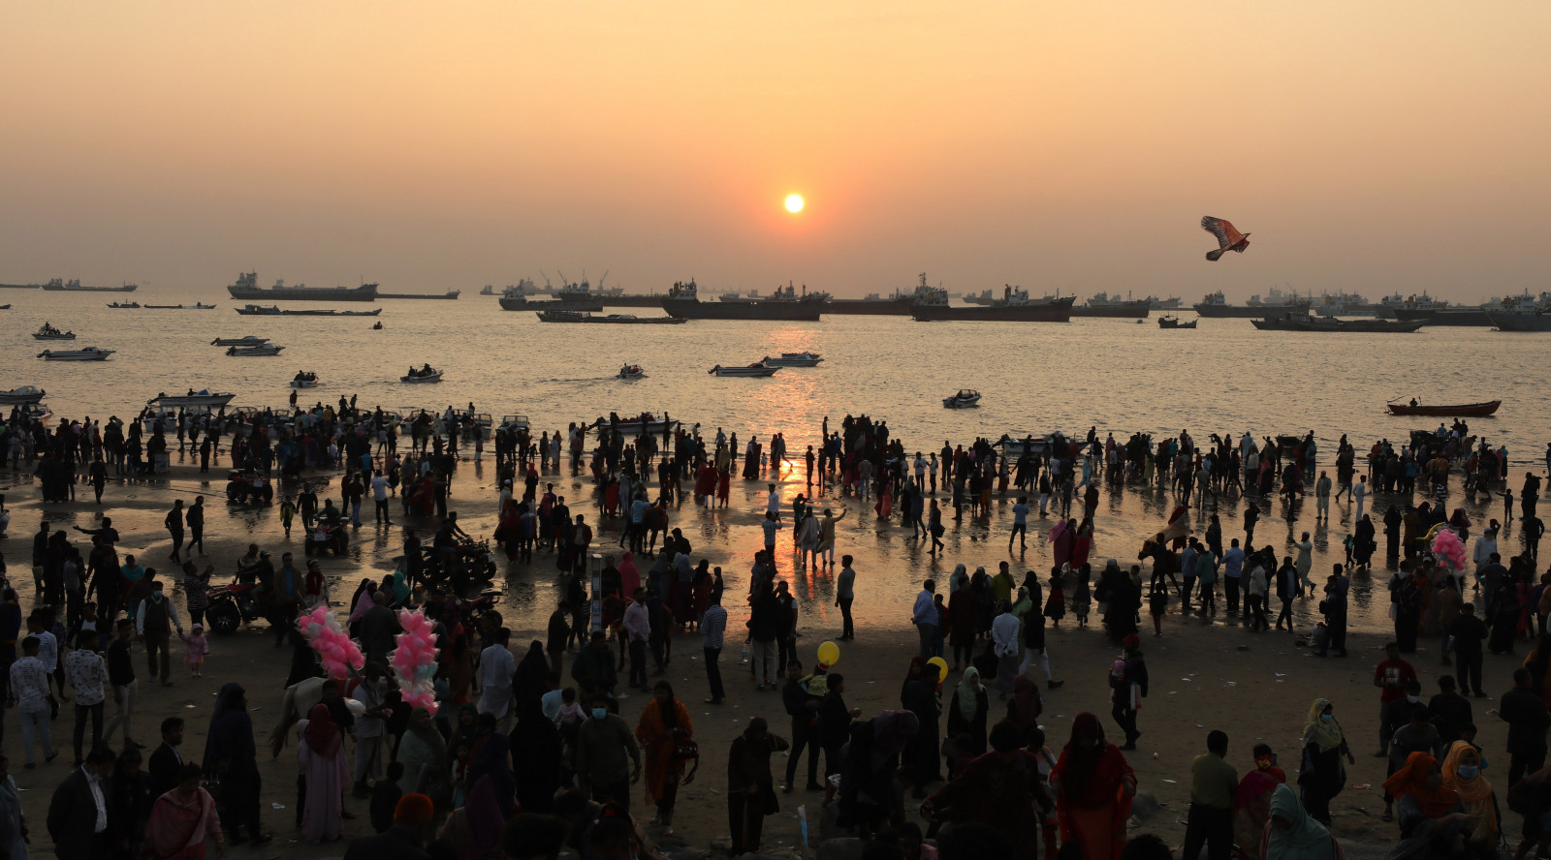
Patenga Beach
Patenga is a popular tourist spot. The beach is very close to the Bangladesh Naval Academy of the Bangladesh Navy and Shah Amanat International Airport.
Its width is narrow and swimming in the seas is not recommended. Part of the seaboard is built-up with concrete walls, and large blocks of stones have been laid to prevent erosion. During the 1990s, a host of restaurants and stands developed out around the beach area. Lighting of the area has enhanced the security aspect of visiting at night.

Slide 15
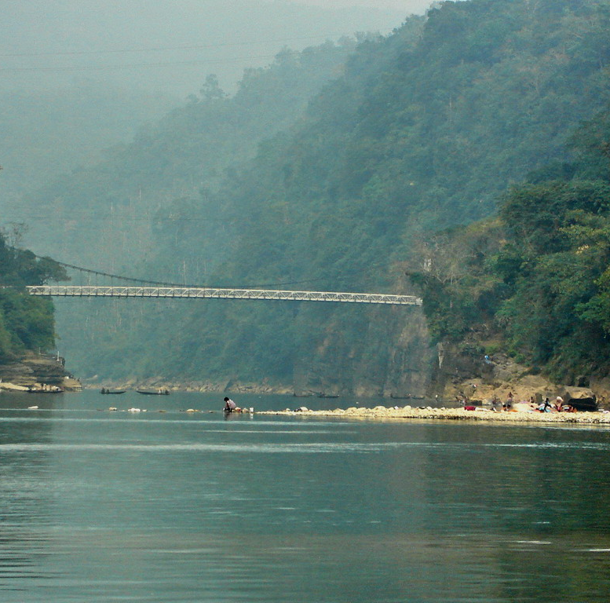
Jaflong
Jaflong, located between tea gardens and hills, is the tourist hotspot of Sylhet, a hill station, positioned on the border between Bangladesh and Meghalaya, the north-eastern state of India. Also home to the Khasi tribe, Jaflong is famed for its lush, tropical setting and the areas of natural beauty surrounding it.
In Jaflong, visitors can also take in the cascading waterfalls and rich greenery of the mountains of Meghalaya, and visit the historic Dawki Bridge, a suspension bridge built by the British in 1932 and a road border crossing between Bangladesh and India.

Slide 16
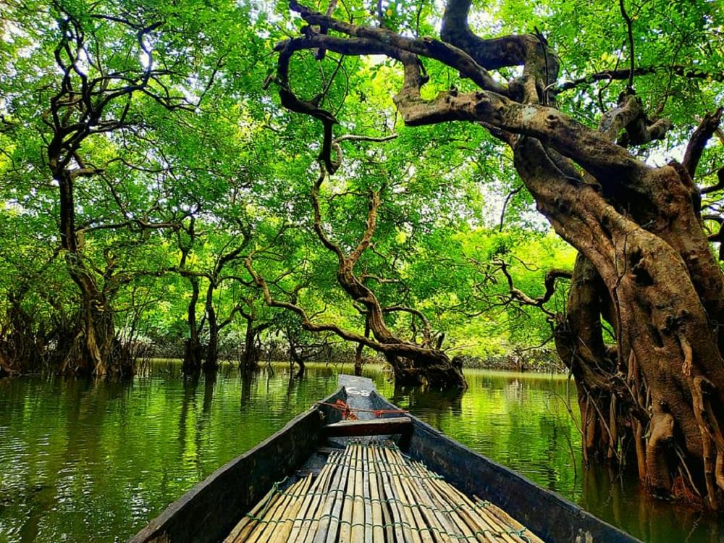
Ratargul Forest
Ratargul Forest is the only fresh water Forest in Bangladesh and maintained by the Forest Department of Bangladesh.
Ratargul Forest stays underwater for five to six months per year. During this time, thousands of tourists come to see the underwater trees. Be sure not to miss beautiful Ratargul Watch Tower. Increase to the top and enjoy the views of the forest.
Various exciting activities, such as kayaking, are available at Ratargul. Kayaks allow visitors the freedom to roam anyplace they wish, enjoying their own pace. Each kayak has capacity for three people,
Ratargul features a variety of wildlife reservations. For example, bird lovers can enjoy findings of various bird types and nature supporter can experience many different kinds of plants.

Slide 17
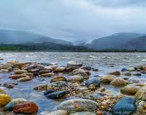
Bholaganj SadaPathor
With extraordinarily similar views to famed hill station Jaflong, Bholaganj SadaPathor, located in the Companiganj Upazila and near East Khasi Hills district of Meghalaya, India, is famous for beautiful stones, crystal clear water and green mountains. In this “heaven of white stones,” visitors can enjoy swimming, floating or simply soaking their feet in the beautiful cool water. Two other must-see places near Bholaganj include Utma Sora and Turong Sora.

Slide 18
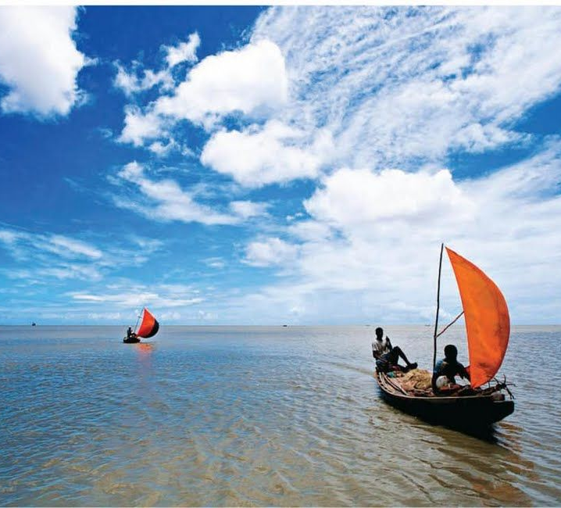
Advantages of Tourism in Bangladesh
Driving force for economic growth
Opportunity of exchanging culture
Infrastructure development
Preservation of heritage sites
Promotion of local products
Increased investment
Helps Global visibility
in creating employment

Slide 19


Slide 20

Conclusion
Bangladesh is a land of beauty. It is a small country but full of tourist spots. Every year a lot of tourists from home and abroad come to visit these sports. There are many tourist spots in Bangladesh. All the tourist spots are very beautiful and wonderful. We can earn a lot of foreign money by developing these tourist spots. Government and people should come forward to take necessary steps to make these spots more attractive to the tourists.

